Slide 1
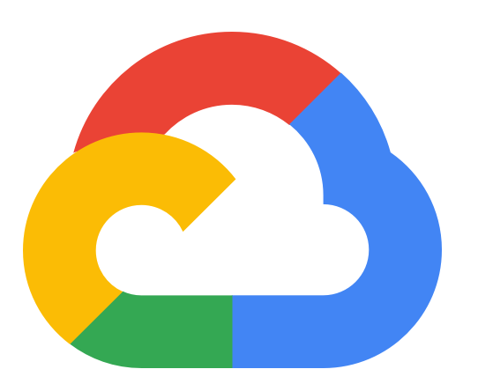
GCP data pipeline
Using GCS, Compute VM, Mage & BigQuery

Slide 2
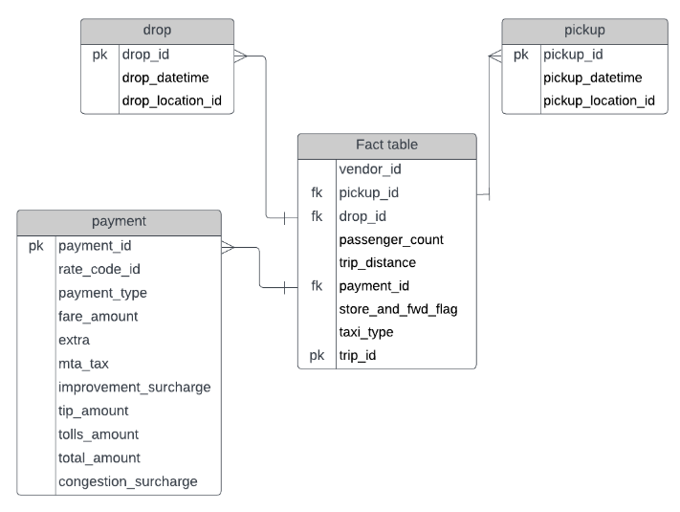
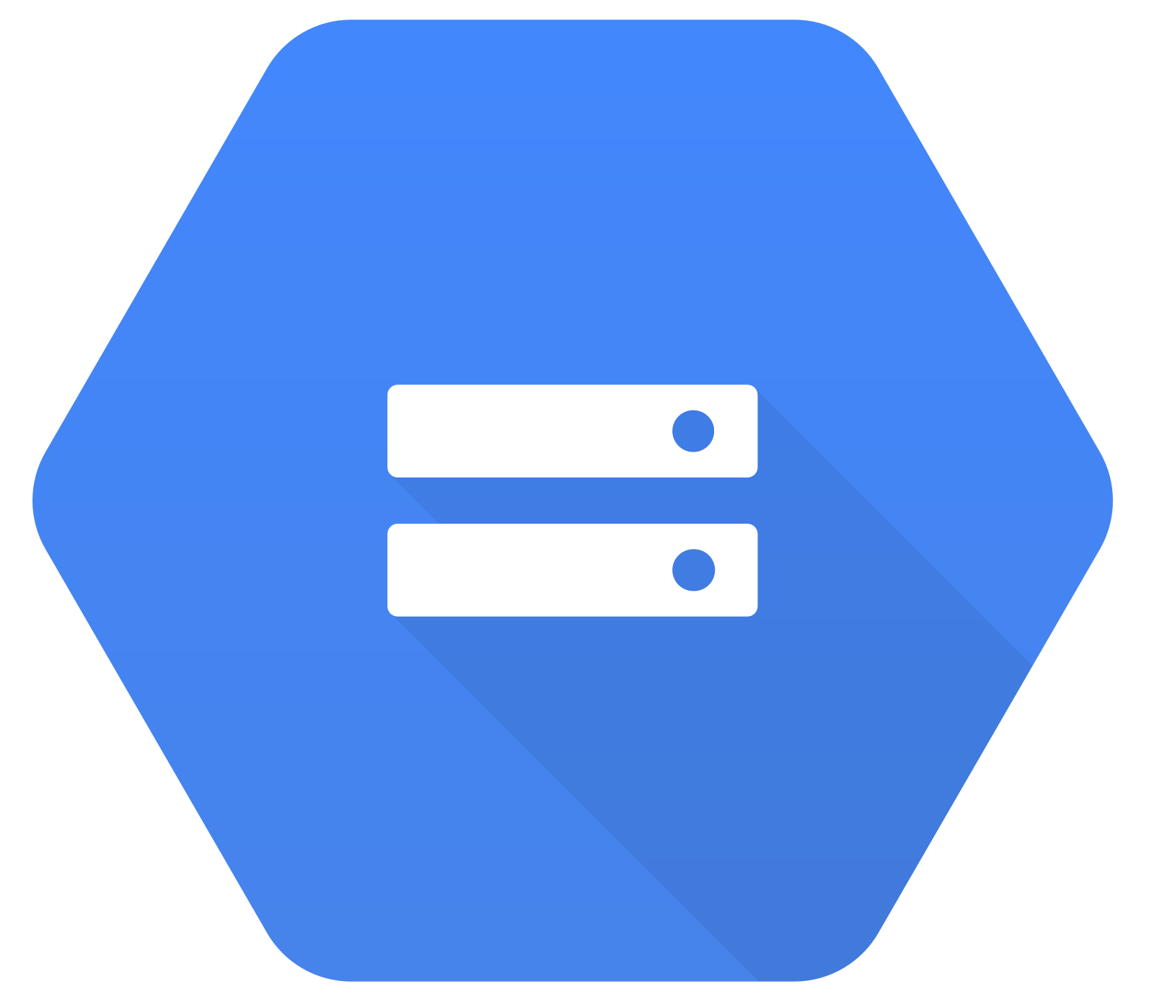


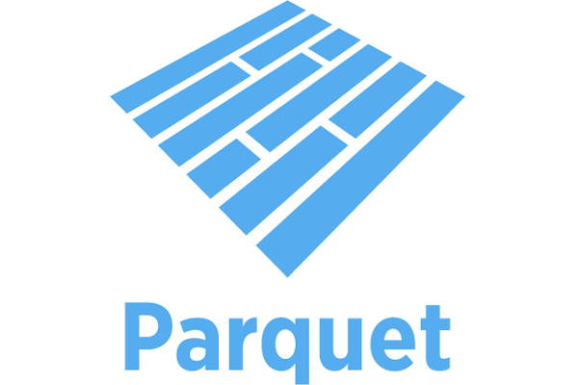

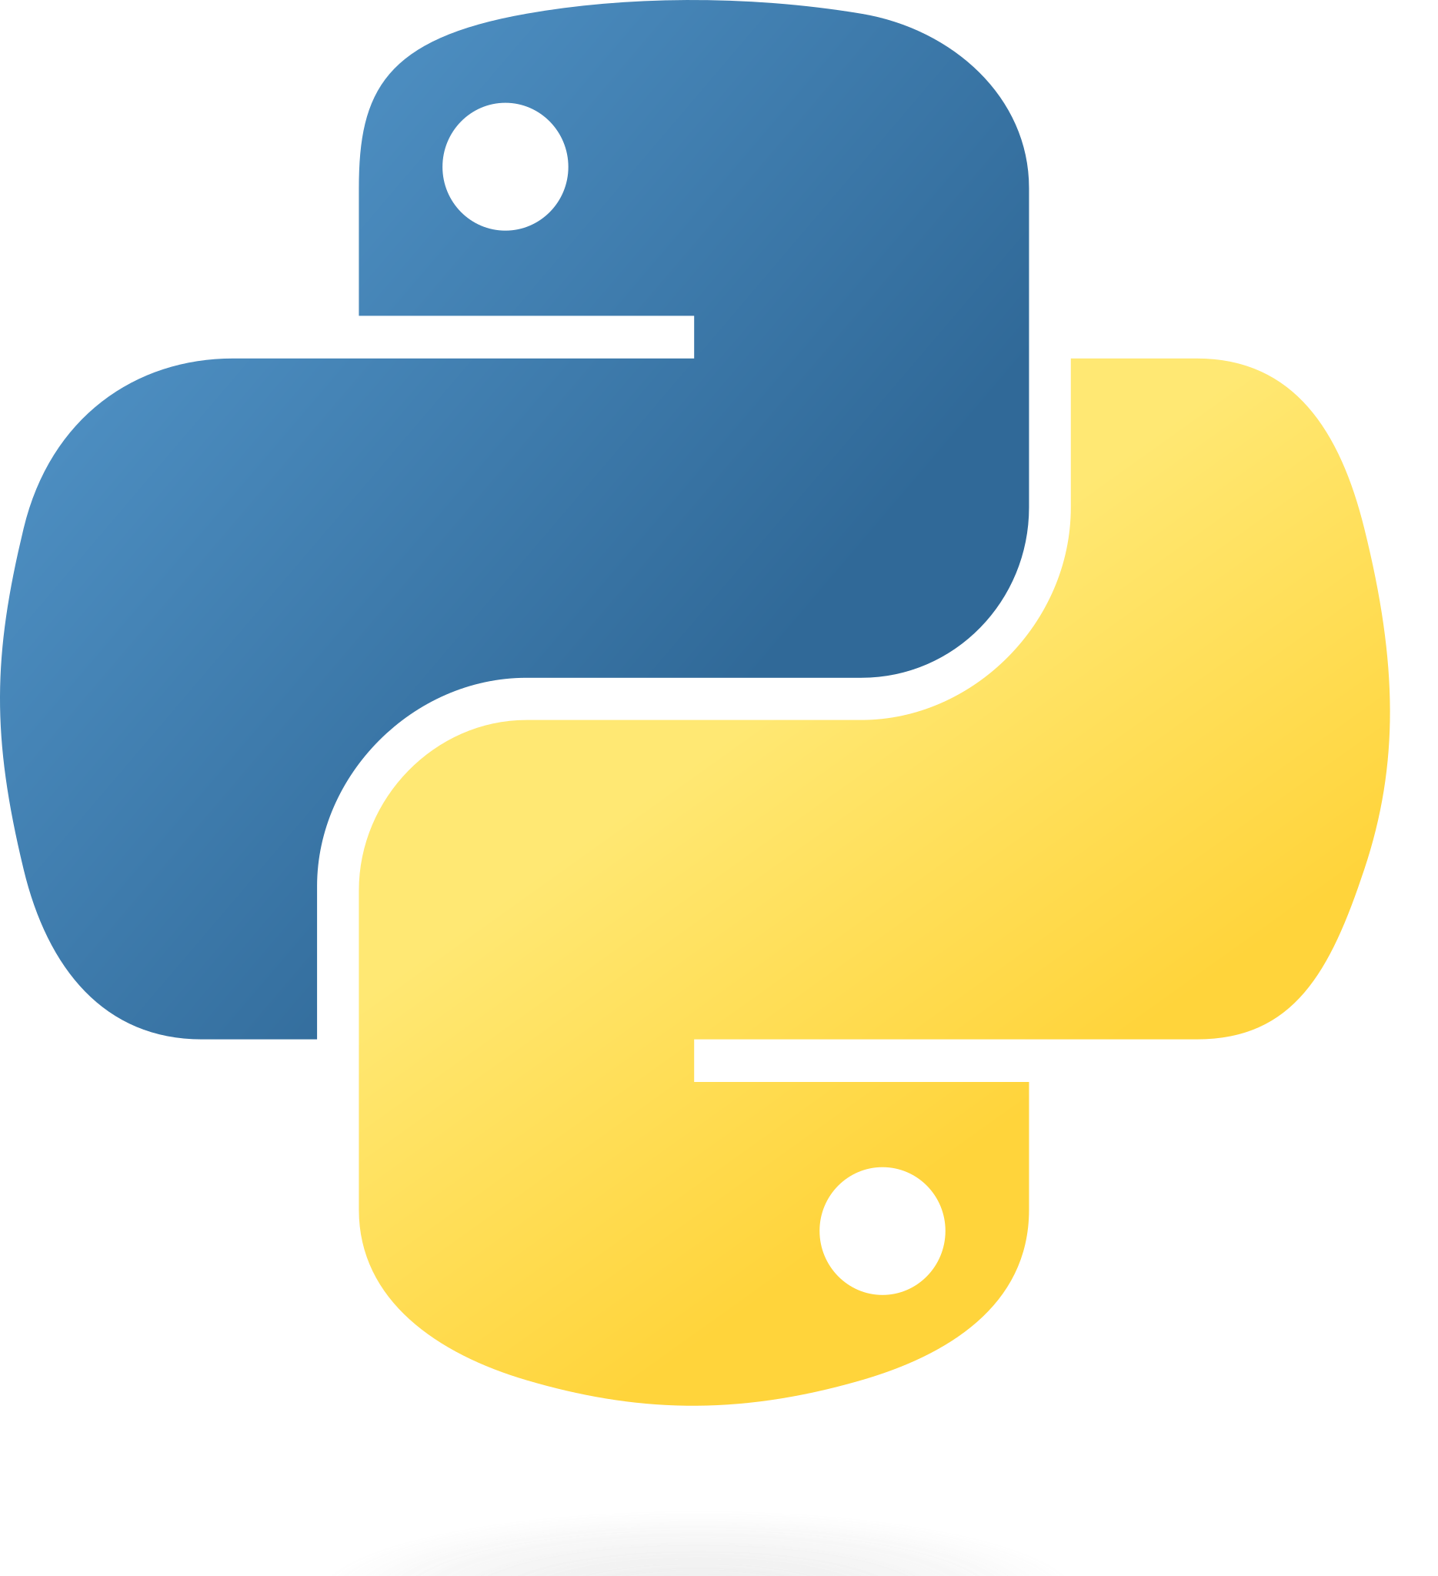

Data Source
Transformations
Data Warehousing
Google Cloud Storage
Google Compute Engine
Google
BigQuery

Slide 3
Google Cloud Storage
Object storage in GCP
Highly scalable
Flexible access control
Object versioning

Slide 4
Pre-built and ready-to-go configurations
Customise VMs with vCPU and memory
Spot machines to reduce costs (low availability)
Google Compute Engine

Slide 5
Mage
Integrate and synchronize data 3rd party sources
Build real-time and batch pipelines to transform data using Python, SQL and R
Run, monitor and orchestrate pipelines

Slide 6
Google
BigQuery
Batch and streaming data writes
Stores data in a distributed and columnar format
Serverless with data caching capabilities

